Slide 1
HEART DISEASE DIAGNOSTIC ANALYSIS
ARIYA BHARADWAJ

Slide 2
Project Title | Heart Disease Diagnostic Analysis
Technologies | Data Science
Domain | Healthcare
Project Difficulty Level | Intermediate
Programming Language Used | Python
Technologies Used | Jupyter Notebook, MS Excel

Slide 3
Table of contents
01
02
03
Problem Statement
Objective
Visual Analytics Dashboard
04
Key Performance Indicator
05
Conclusion

Slide 4
Problem Statement
In the wake of the COVID-19 pandemic, the importance of health has been profoundly recognized across all societal strata. This project involves analyzing heart disease diagnostic data to enhance future health preparedness. The tasks include performing ETL, conducting EDA creating a comprehensive dashboard.

Slide 5
Objective
The goal of this project is to analyze heart disease diagnostic data to identify key metrics and relationships among attributes such as age and gender. We aim to provide actionable insights to enhance future health preparedness and inform healthcare strategies.

Slide 6
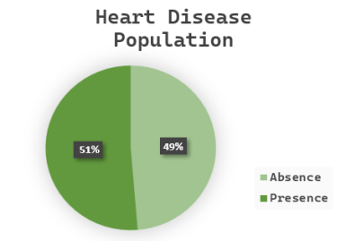
Visual Analytics Dashboard
51 % of people are suffering from Heart Disease

Slide 7
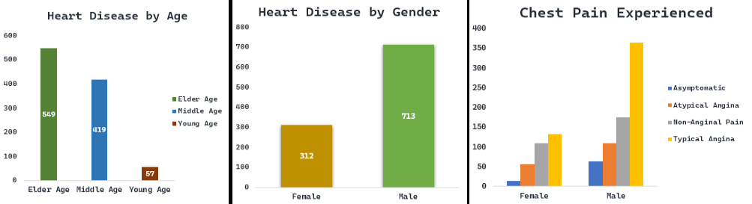
Individuals in the older age group are more predisposed to heart disease than those in the middle-aged and younger age groups.
Males experience a higher rate of heart disease compared to females.

Slide 8
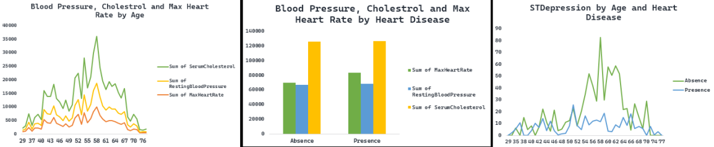
The age of 59 is associated with a high rate of ST depression and heart disease.
The occurrence of typical angina chest pain is higher in males than in females.

Slide 9
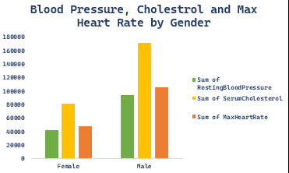
The age of 58 is marked by elevated blood pressure, cholesterol, and heart rate.
The incidence of high blood pressure, cholesterol, and heart rate is greater in males than females.

Slide 10
Key Performance Indicator
Percentage of Individuals Suffering from Heart Disease.
Age distribution analysis based on Gender.
Gender Demographics of Heart Disease Patients.
Occurrence of Chest Pain in Heart Disease Patients According to Gender.
Age and Gender Trends in Blood Pressure, Cholesterol, and Maximum Heart Rate.
Analysis of ST Depression in Relation to Age and Heart Disease.

Slide 11
Conclusion
51% People suffering from heart disease.
Individuals in the older age group are more predisposed to heart disease than those in the middle-aged and younger age groups
Males experience a higher rate of heart disease compared to females.
The age of 59 is associated with a high rate of ST depression and heart disease.
The occurrence of typical angina chest pain is higher in males than in females.
The age of 58 is marked by elevated blood pressure, cholesterol, and heart rate.
The incidence of high blood pressure, cholesterol, and heart rate is greater in males than females.

Slide 12

Thank You

